Slide 1
King County House Prices Exploratory Data Analyses
Stakeholder : Bonnie Brown (Seller) He as a house and wants to move soon (timing?), but wants high profit in middle class NH (neighborhood)
Hypothesis:
House prices are high in city center
waterfront Houses are expensive
Best time for selling a house in mid of the year ( Jun –July)
After renovation the price will be increased

Slide 2
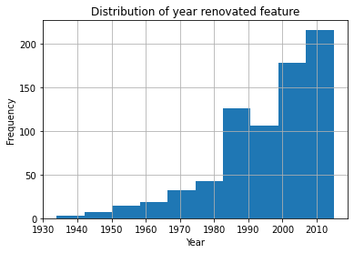
Data Cleaning
date feature is converted to DateTime type
NaN values are replaced:
waterfront 99% of the values are 0 therefore all NAN values in this data series are replaced by 0.
view 90% of the values are with 0’s and this data is categorical variable data. In this analyses this data will be with 0’s and 1’s i.e. 0 = not viewed, 1 = viewed. Therefore all NAN values are replaced by 0’s
new feature = has_veiwed
yr_renovated this is also kind of categorical data like renovated = 1, not renovated = 0 in last 15 years. All renovations before 1990 are obsolete and assigned to 0. Similarly all NaNs are replaced with 0.
New feature = has_renovated

Slide 3
Data Cleaning
The following analyses shows that sqft_basement feature is identified as object instead of float since it has `?` character in the dataset and 59% of the houses haven’t basements.
For quick analyses this feature also considered as categorical variable feature like house has basements = 1 or not = 0
A new feature has_basement feature created and dropped sqft_basement feature

Slide 4
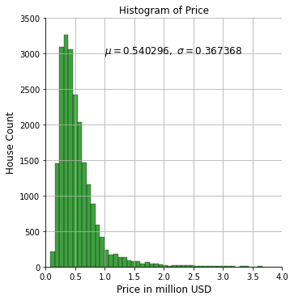
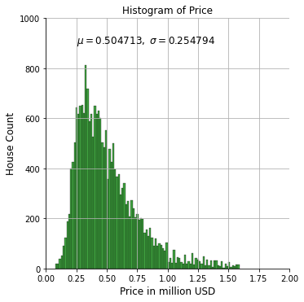
Analyses of price distribution
From price distribution graph, the houses with price above $1.6m are very few and can be considered as outliers. In this project for simplification the data of houses above 1.6m USD are removed

Slide 5
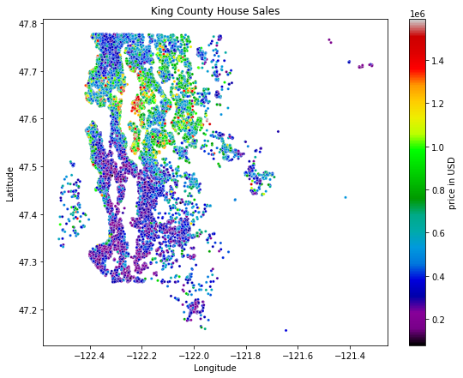
House price distribution

Slide 6
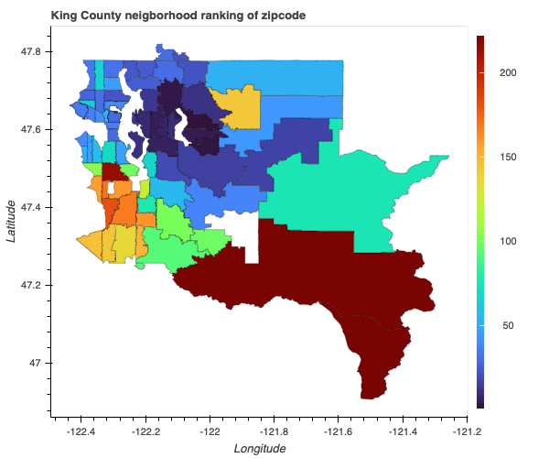
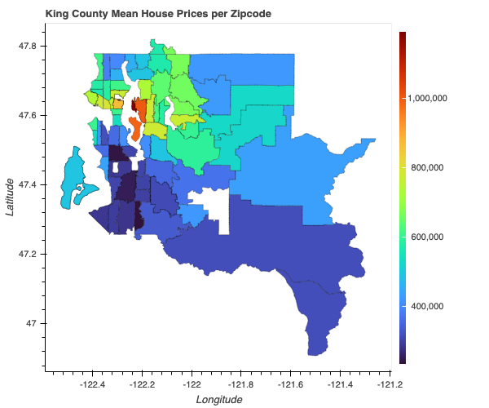
Analyses of price distribution and neighborhood
Price in USD
Best = 1
houses above 1.6mUSD are not considered in this analyses

Slide 7
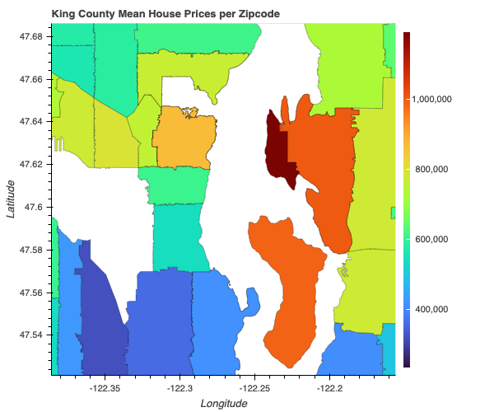
Max mean price
98112
98109
98004
98039
98040
Top 5 places:
Medina
Clyde Hill /
Mercer Island
Madison Park
Kenmore Air Harbor
houses above 1.6mUSD are not considered in this analyses

Slide 8
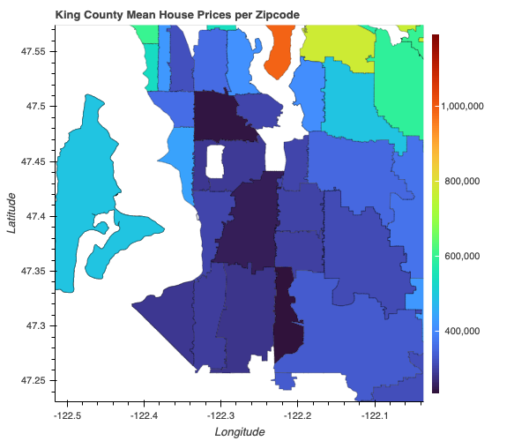
Min mean price
98168
98148
98032
98001
98002
Bottom 5 places:
South Auburn
Burien
Kent
Auburn
Burien
houses above 1.6mUSD are not considered in this analyses

Slide 9
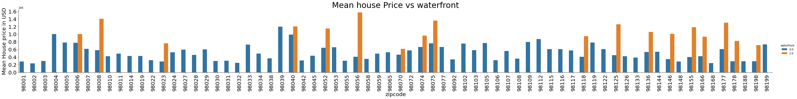
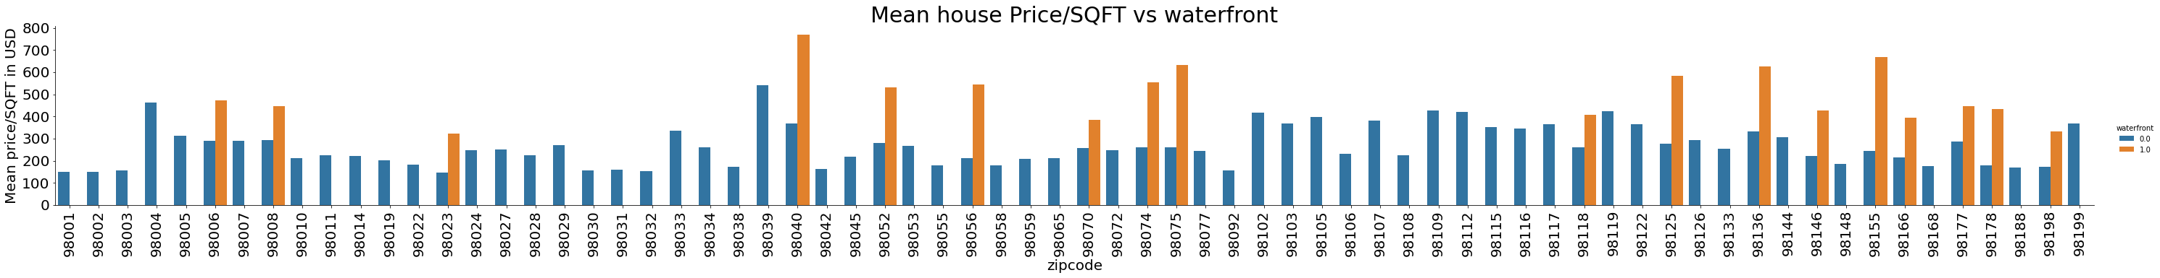
Sales, price vs waterfront
houses above 1.6mUSD are not considered in this analyses

Slide 10
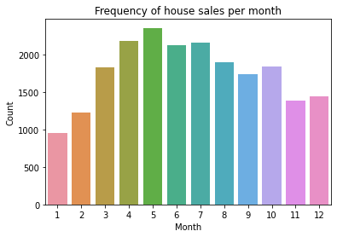
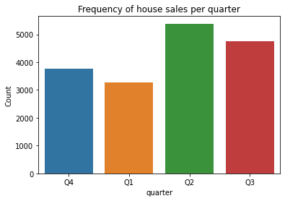
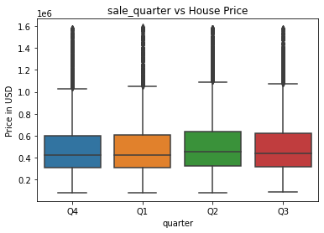
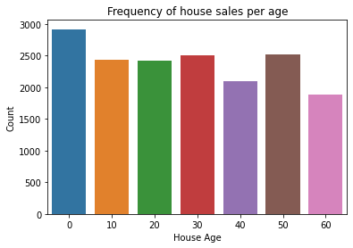
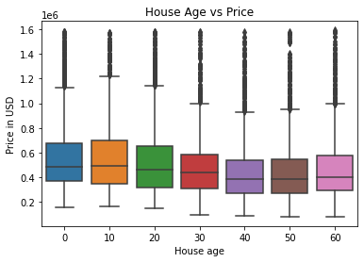
House sales analyses
houses above 1.6mUSD are not considered in this analyses

Slide 11
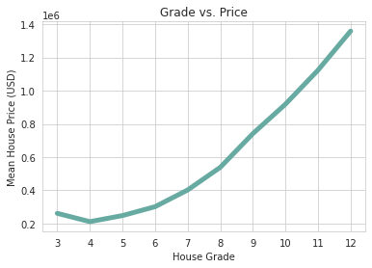
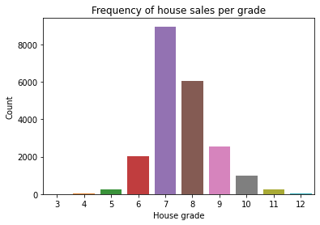
House sales per grade

Slide 12
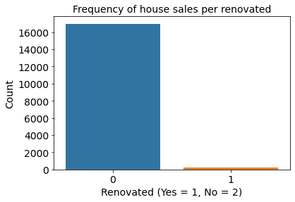
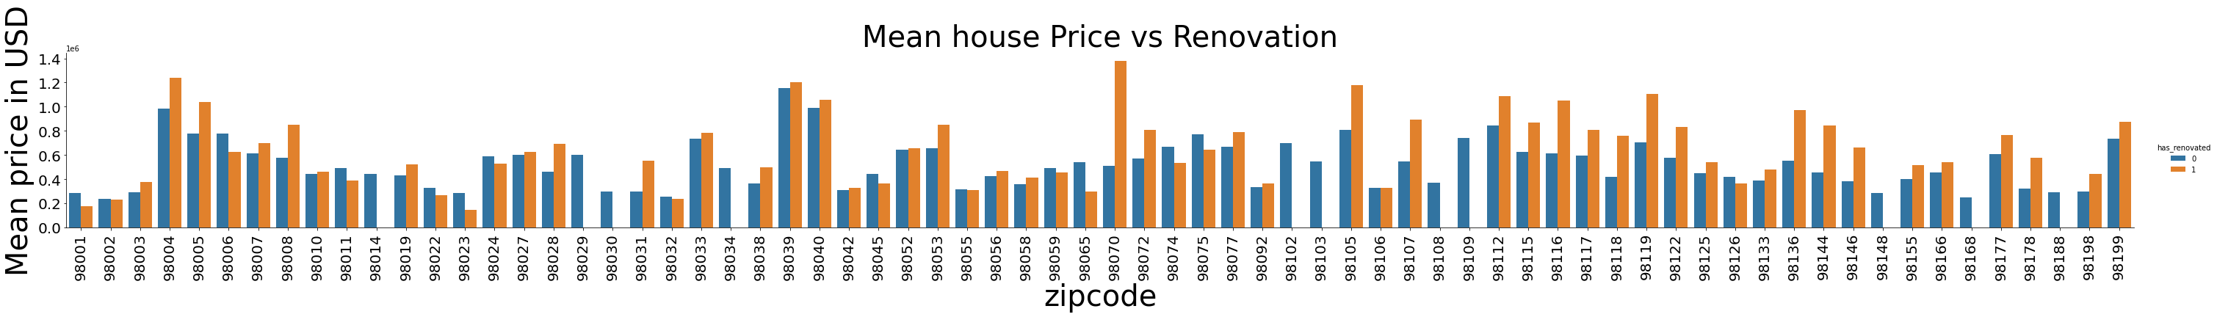
Renovation vs sales
Post 1990renovations are obsolated, houses above 1.6mUSD are not considered in this analyses

Slide 13
Price vs waterfront

Slide 14
Price vs renovation

Slide 15
Price vs month

Slide 16
Price vs all features ( incl. dummies)

